Slide 1
Vice President Membership Vice President Public Relations
District 49 Club Officers Training, August 15, 2020
– Breakout session –
Slava Slavik, District 49 Public Relations Manager

Slide 2
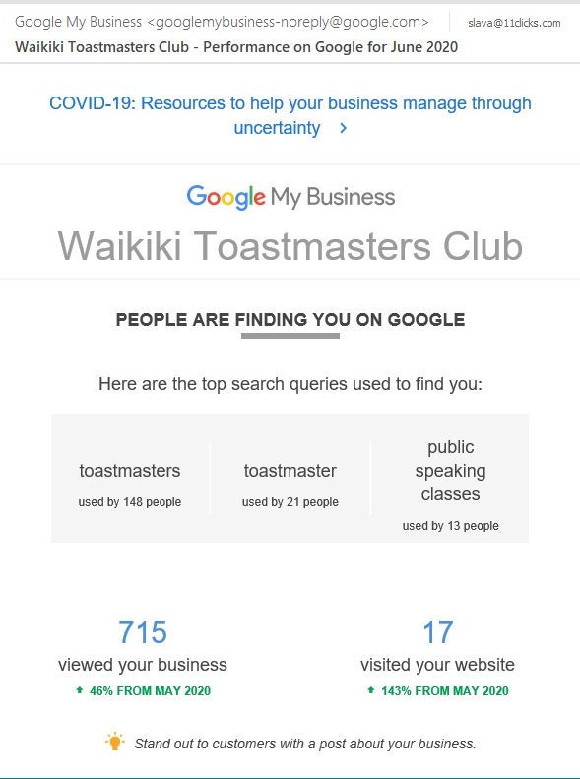
Good News
People are
INTERESTED
In Toastmasters
Search “Toastmasters”
46% more

Slide 3
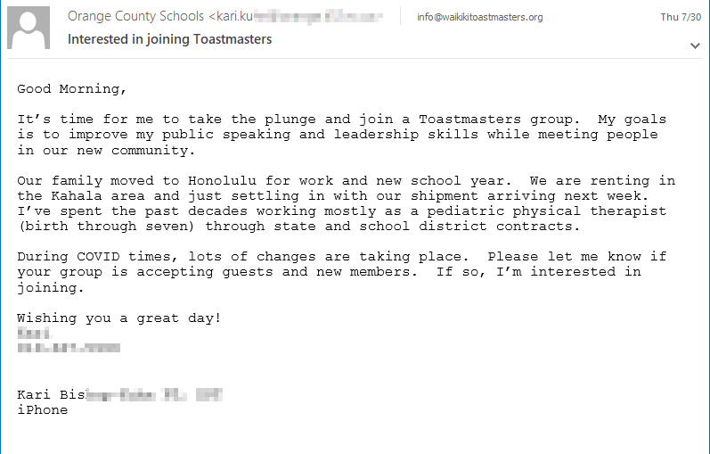
Good News
People are
contacting us

Slide 4
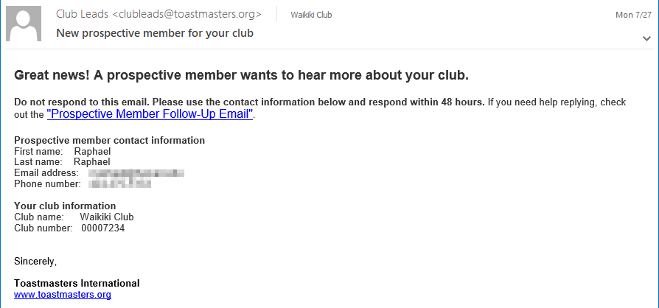
Good News
People are
contacting us

Slide 5
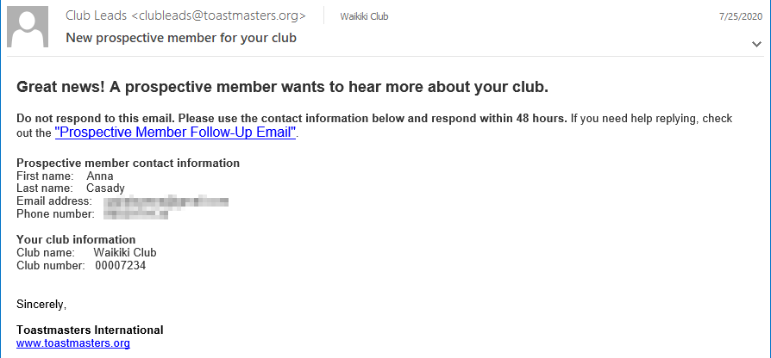
Good News
People are
contacting us

Slide 6
Good News
People are
contacting us

Slide 7
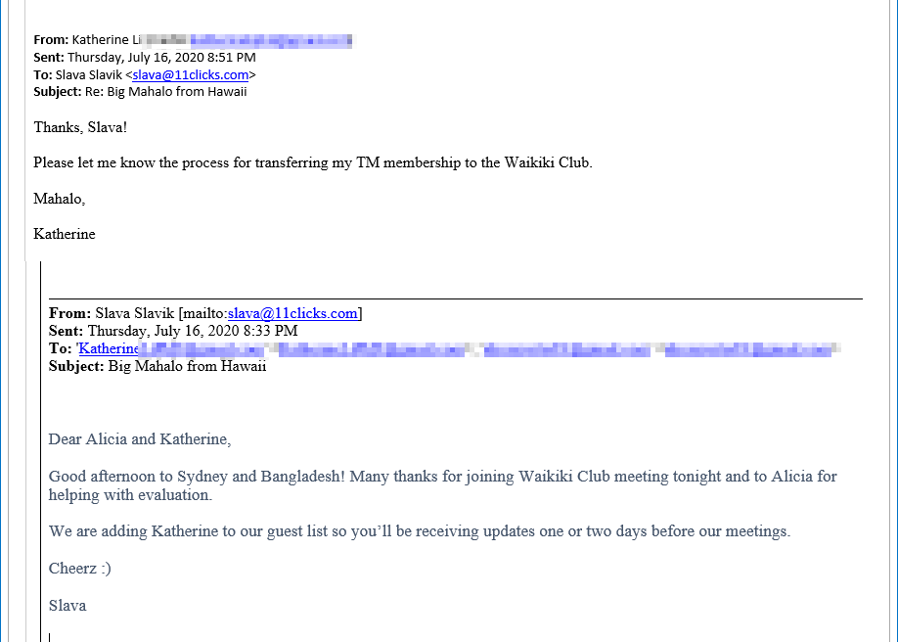
Good News
People are
contacting us

Slide 8
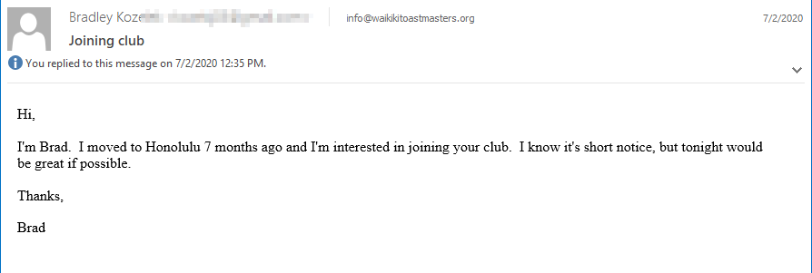
Good News
People are
contacting us

Slide 9
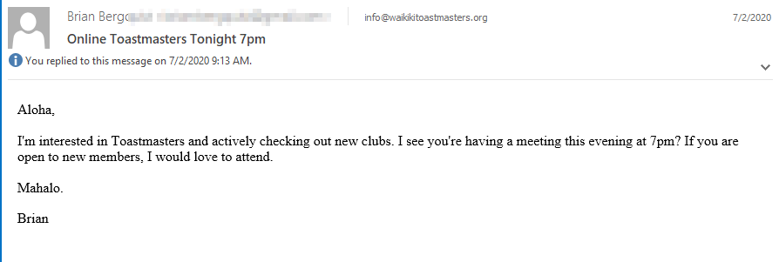
Good News
People are
contacting us

Slide 10
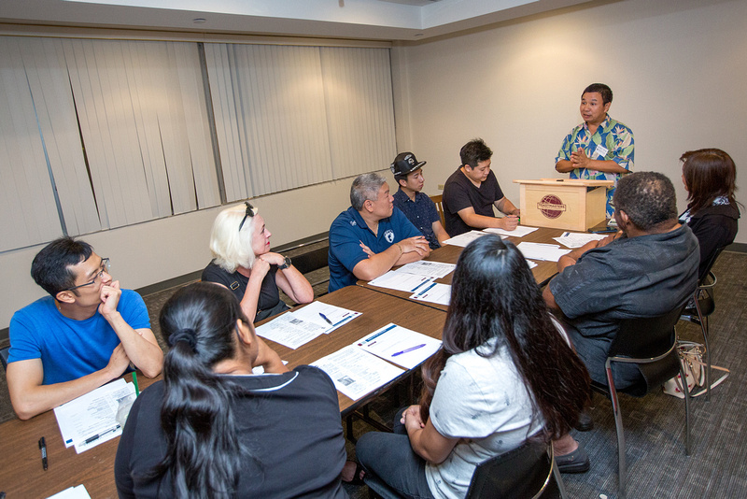
Making Connections

Slide 11
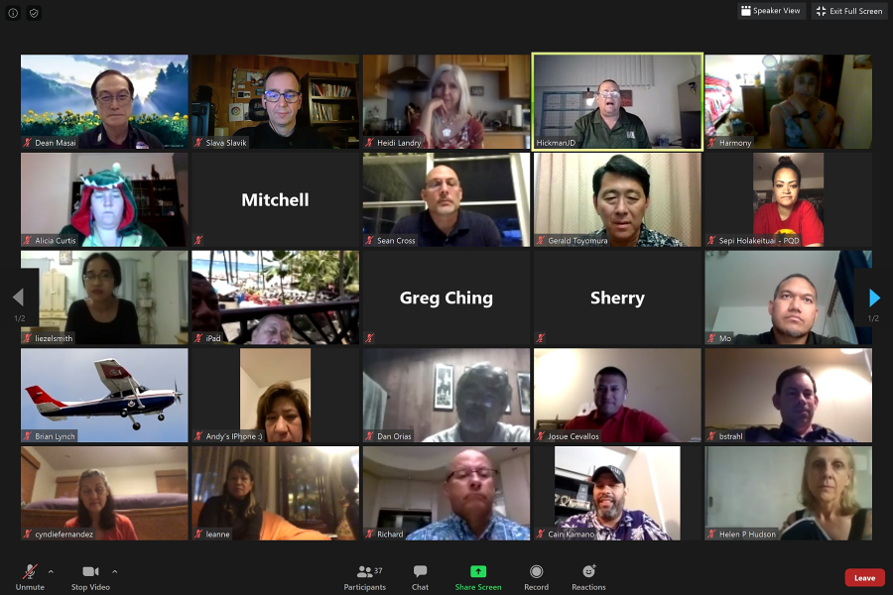
Making Connections
summer 2020

Slide 12
Making Connections
Doing good for the interested people
Doing good for the club
Doing good for you

Slide 13
Breakout Session
Vice President Membership Vice President Public Relations

Slide 14
AGENDA
VP Membership - Responsibilities
VP PR - Responsibilities
Resources for Both Roles
Your Ideas (1)
Summer 2020 – What’s Different
New Branding
Your Ideas (2)
One More Thing…

Slide 15
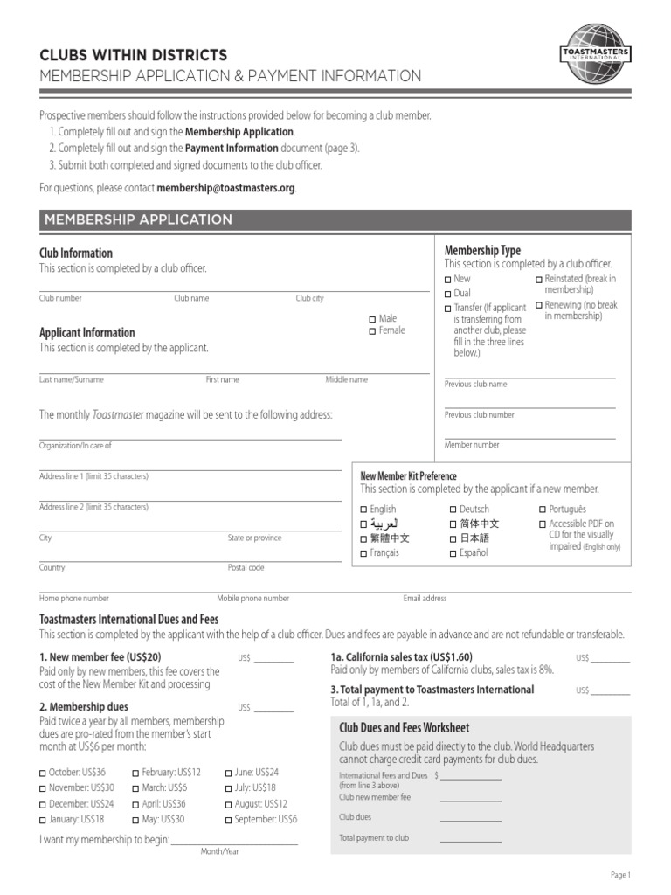
Vice President Membership
Greets guests and members
Provides guest packets to prospective members
Answers their questions
Collects their contact info
Follows up with guests
Keeps track of the contact info
Assists with Membership Application

Slide 16
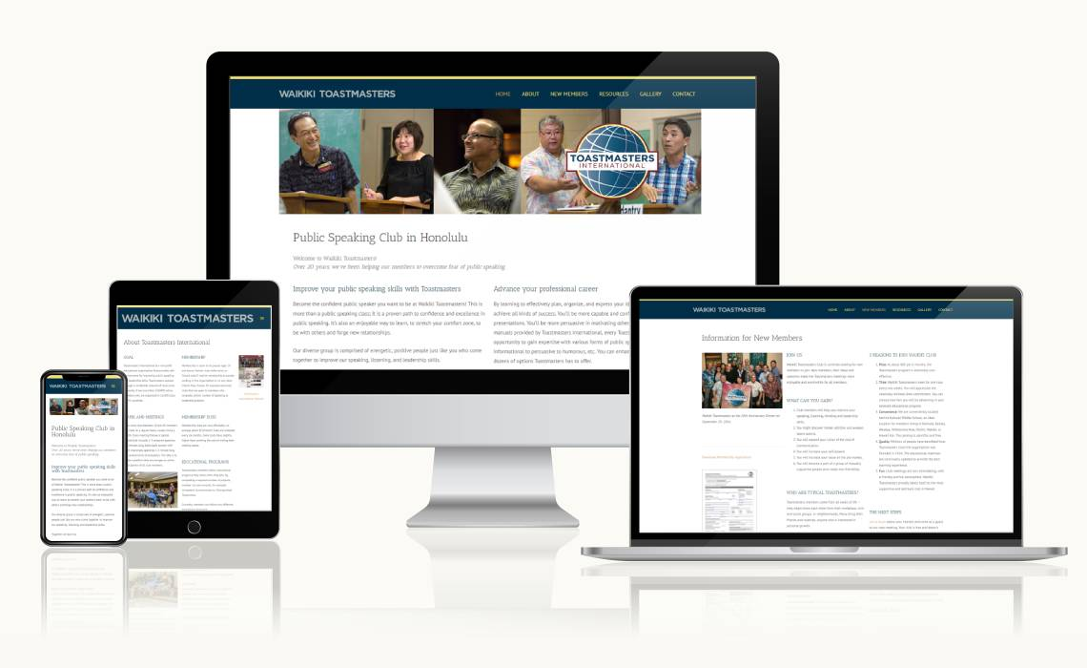
Vice President Public Relations
Keep website up to date
Keep live social media presence
Connect on social media
with other clubs and districts
Safeguard Toastmasters brand
Reach to local media
Promote membership building
Publish club newsletter (?)

Slide 17
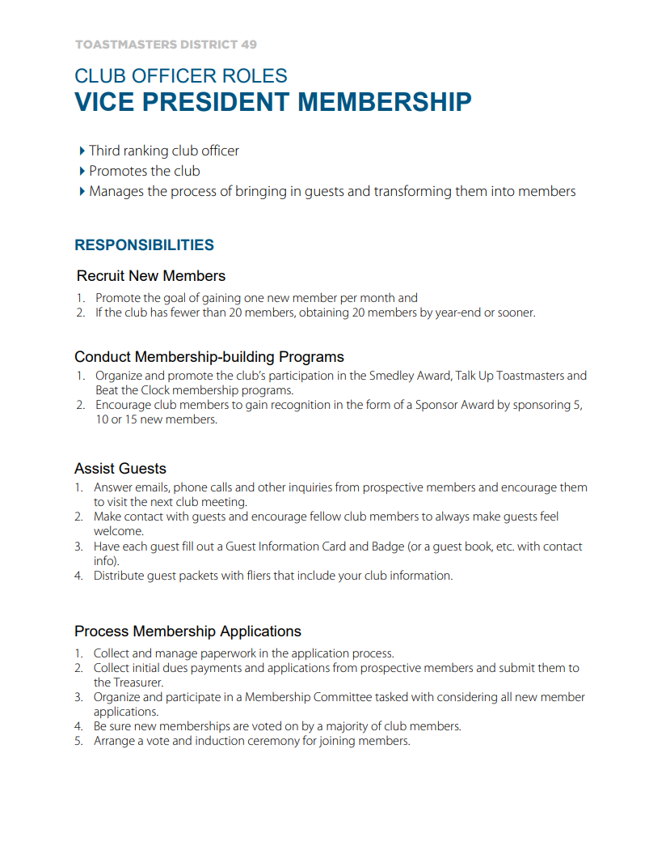
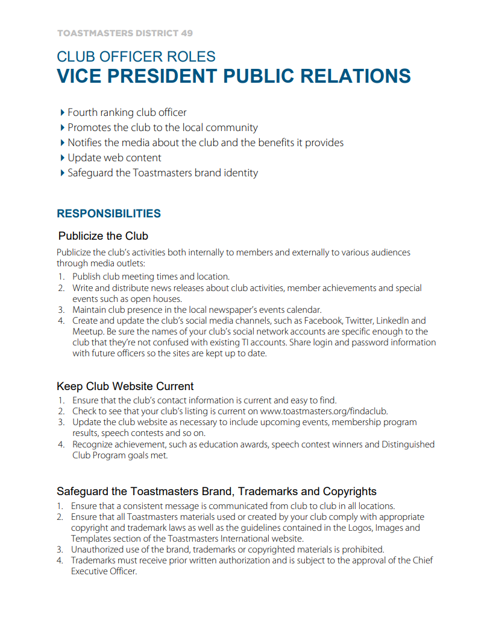
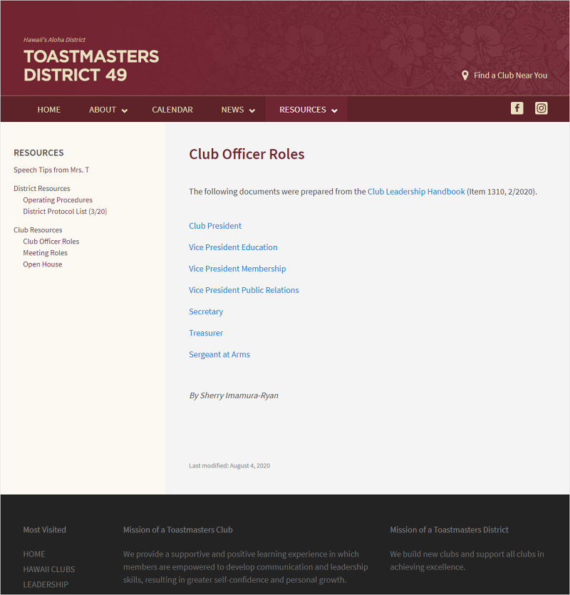
Resources
district49.org/resources-club-officers/

Slide 18
Your Ideas - 1
17 ideas from 6 Club Officers
CORPORATE INCENTIVE
$50 Amazon Gift Card
Contribution - TI Dues
Attractive promo email
Congratulations:
Shelly Santo
Nordic PCL Club

Slide 19
Your Ideas – 1/3
Well promoted virtual open house
Facebook or LinkedIn
Video Welcome Message
Video Testimonials
Mass Email Campaign to Guests
Word of Mouth

Slide 20
ADAPT TO THE PANDEMIC LIMITATIONS
YES - Clubs Can Grow and Serve their Members
District 49 between April and July 2020
- 107 brand new members
- 3 new clubs

Slide 21
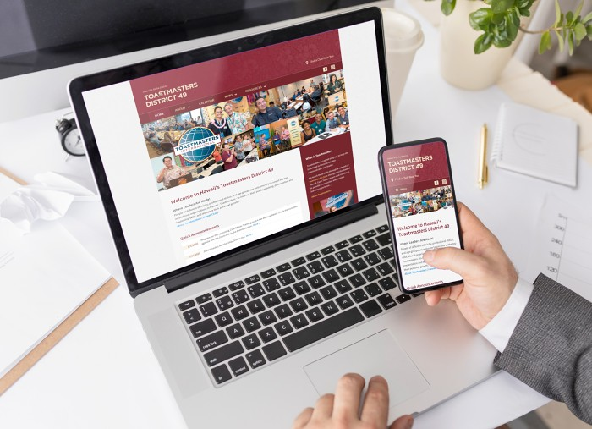
From the initial contact…
Start with your club website
Visit your website and look at it as someone who doesn’t know anything about Toastmasters.
District 49 Fall Initiative:
- Guidelines to help improve websites
- Outstanding Club Website Contest

Slide 22
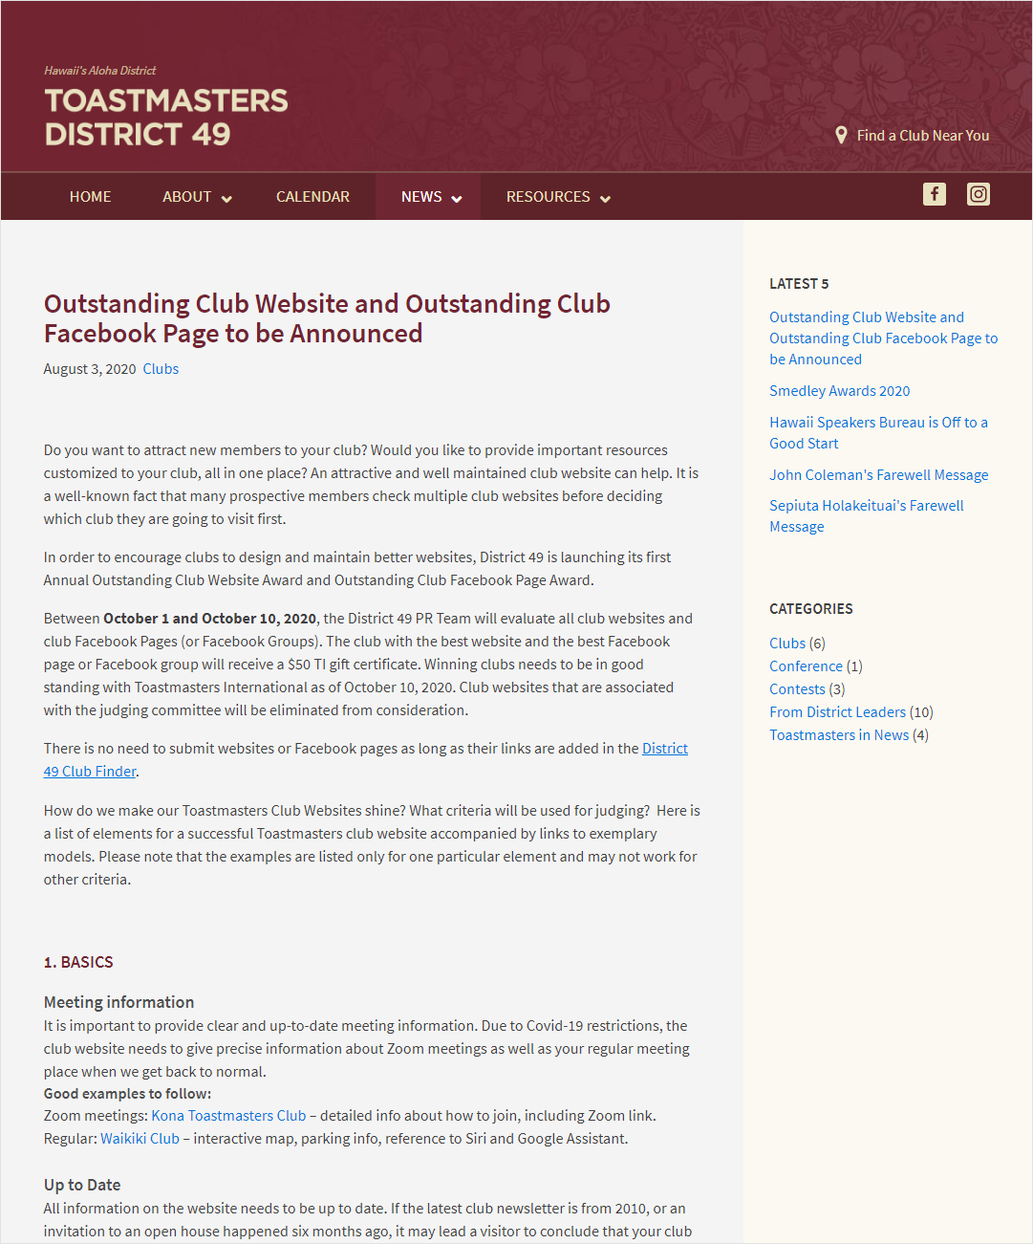
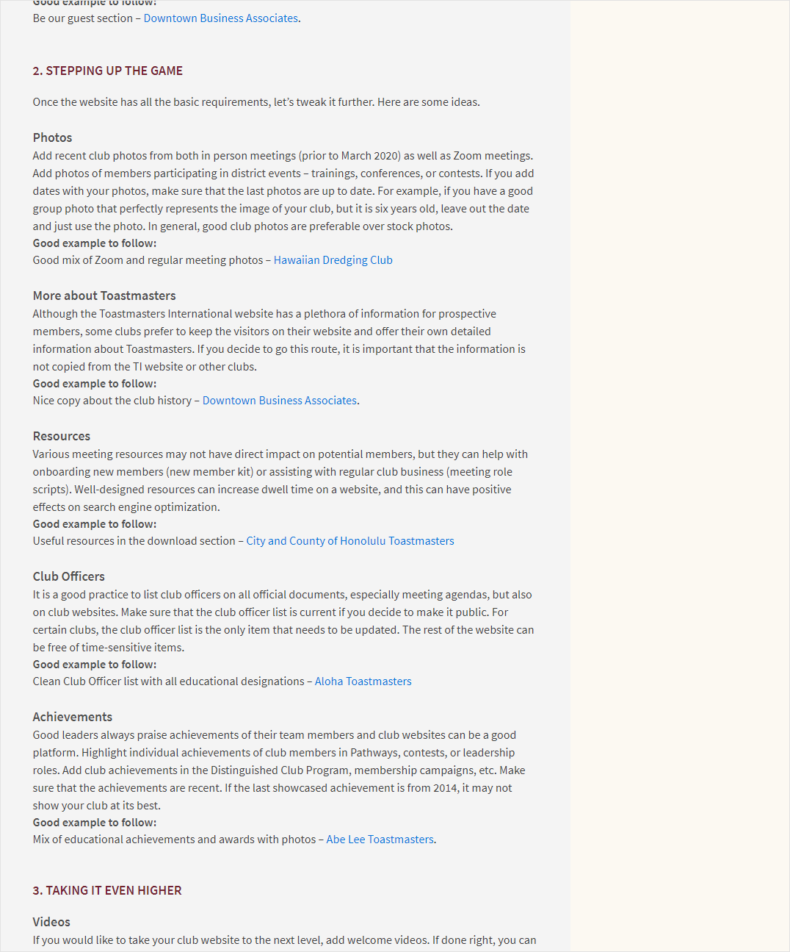
From the initial contact…
Detailed guide on D49 website

Slide 23
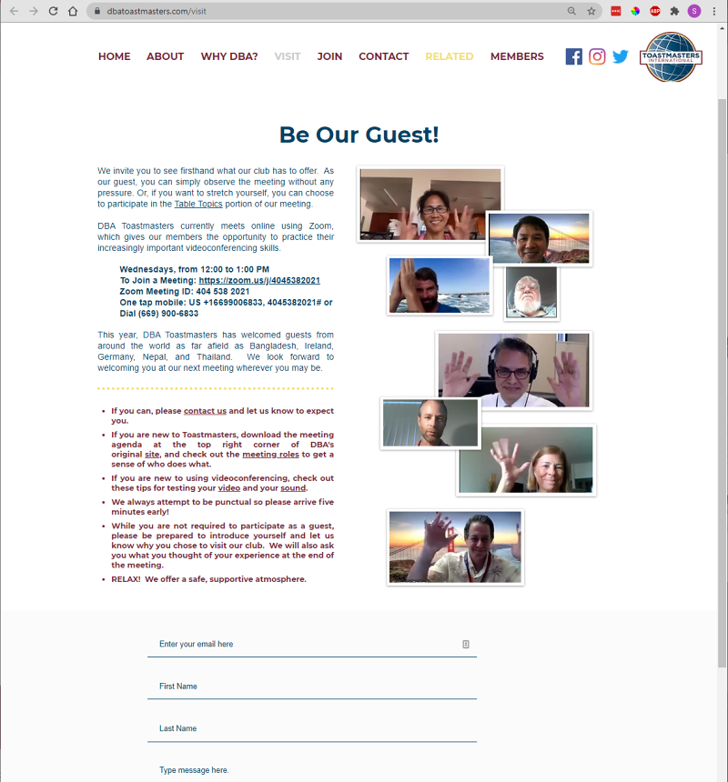
From the initial contact…
Meeting Information
(Zoom and regular)
Up to date
Mobile Responsive
TI Brand Compliant
Connects with visitor
(and calls to action)

Slide 24
From the initial contact…
Test who receives messages from the club website
Create ‘canned’ reply
Send reply as soon as possible (TI: 48 hours, some clubs: same day)
• Next meeting date and time, zoom
• Regular meeting location
• Call to action
• Link to “Guest Packet” – The Navigator
• Subscribe Newsletter
• Welcoming and positive ending

Slide 25
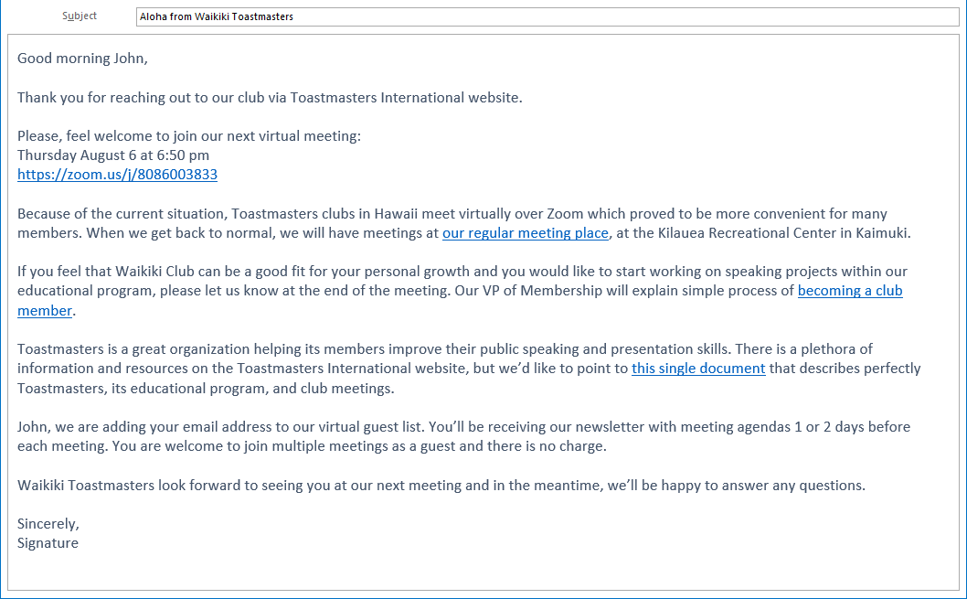
From the initial contact…
Sample Reply Email

Slide 26
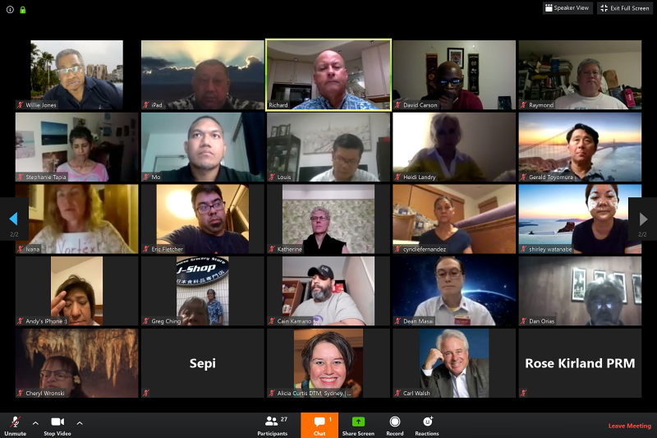
… to visiting the meeting …
Be first in the virtual room
Welcome people as they log in
Try to acknowledge everyone

Slide 27
… to signing the contract
One on one talk after the meeting
Explain TM membership and payments
Provide link to fillable PDF TM application

Slide 28
Toastmasters Brand
Brand Refresh July 2020
Clean (up-to-date look)
Rays are being silently retired
[link]

Slide 29
Rays are gone

Slide 30
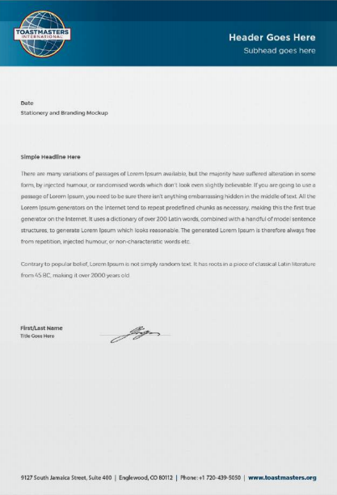
Rays are gone

Slide 31
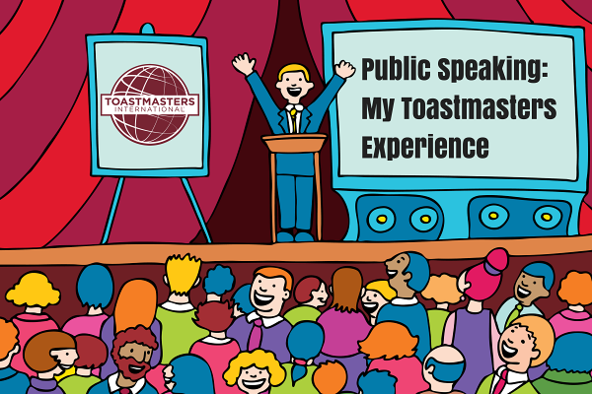
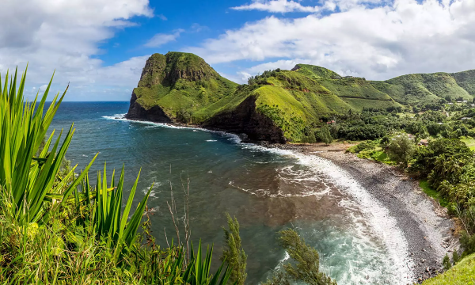
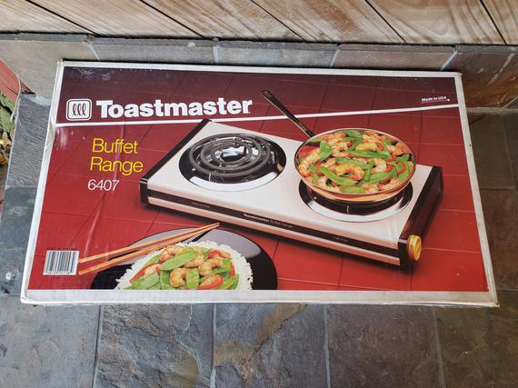
BRAND
Protecting
Brand
Integrity

Slide 32
BRAND
Protecting
Brand
Integrity
But…
… what if I want my club to
STAND OUT

Slide 33
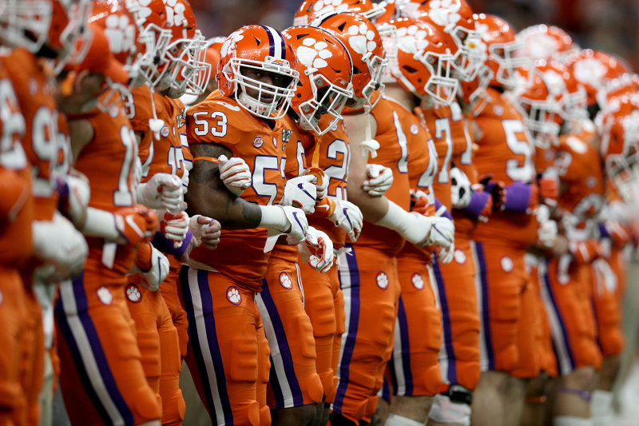
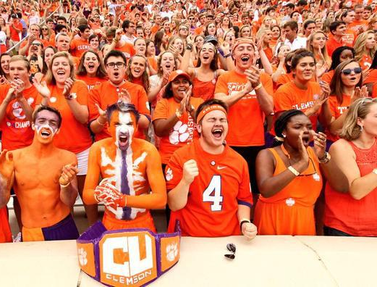
BRAND
TEAM
PRIDE

Slide 34
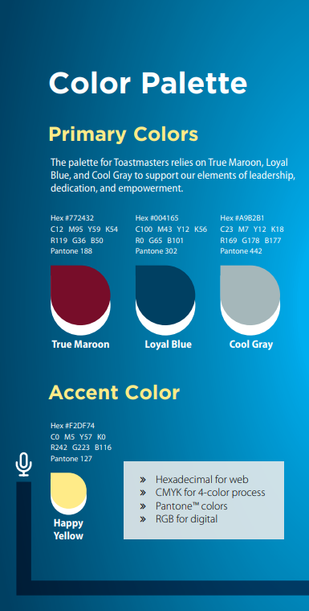
BRAND
Protecting
Brand
Integrity
COLORS:

Slide 35
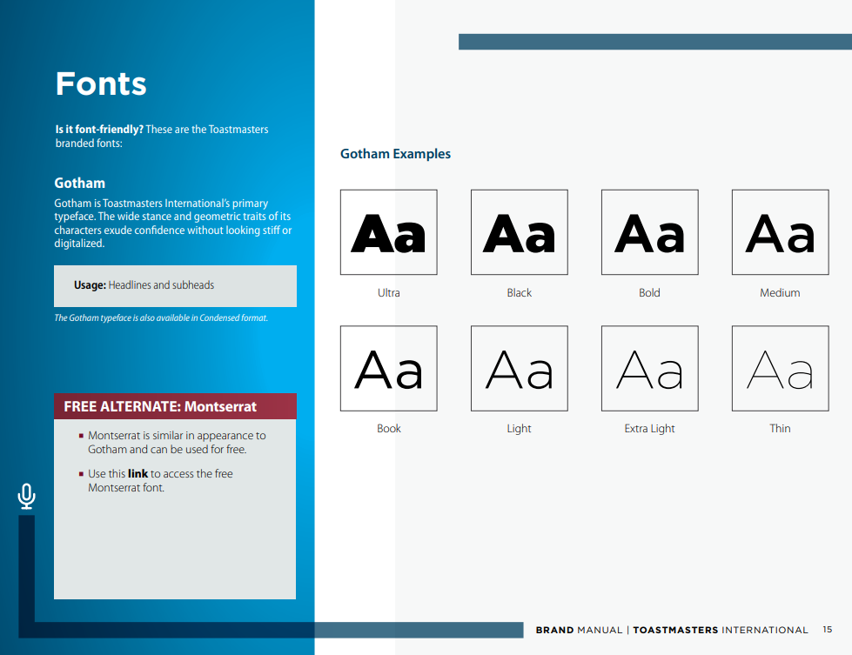
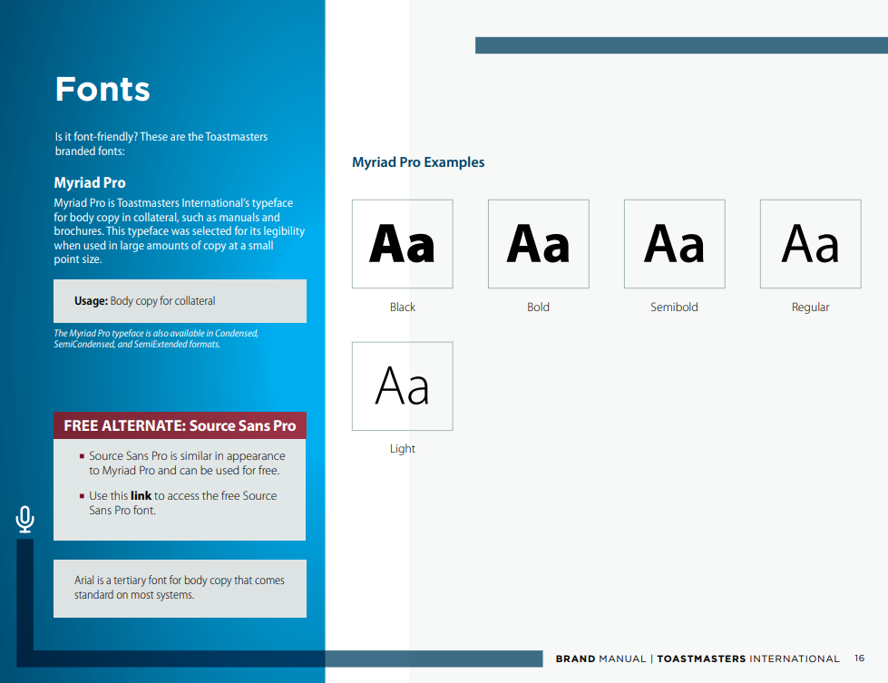
BRAND
Protecting
Brand
Integrity
FONTS:
Gotham
(Montserrat)
Myriad Pro
(Source Sans Pro)
(Arial)

Slide 36
BRAND
Protecting
Brand
Integrity

Slide 37
BRAND
Discussion…

Slide 38
Your Ideas – 2/3
Pride of TM Membership
Read Club Mission
Installation Ceremonies
Wear TM Branded Apparel
Publish success stories of members
Wear TM Pins

Slide 39
Your Ideas – 3/3
Protect Time Investment of Members
Assign Mentors
Involve members in promoting
Every member needs to speak
Track Progress

Slide 40
5 TAKEAWAYS
VPM and VPPR resources on the D49 website
Improve your Club website – Guidelines on the D49 website
(LEARNING LAB – Lina Carahasen, Danilo Orias)
Dealing with Covid Pandemic
- Proper mindset
- Adjusted procedures
• Protect Toastmasters brand and play as a team member
• Back to basics: PRODUCTIVE AND FUN MEETINGS

Slide 41
Special Thanks to:
Shelley Santo - Nordic PCL
Amy Este - Mililani
Dr. Ken Siu - Winners Circle II
Karen Speed - Abe Lee
Michael Aviles - Phoenix Raising
Carolyn Kaichi - Hilo

Slide 42
Questions…
pr@district49.org

Slide 43
One more thing…
??

Slide 44
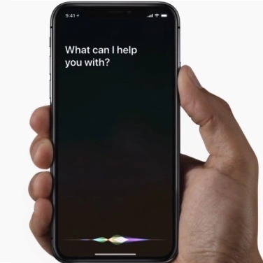
Ask Siri (or Google):
“Get me to Waikiki
Toastmasters Club”

Slide 45
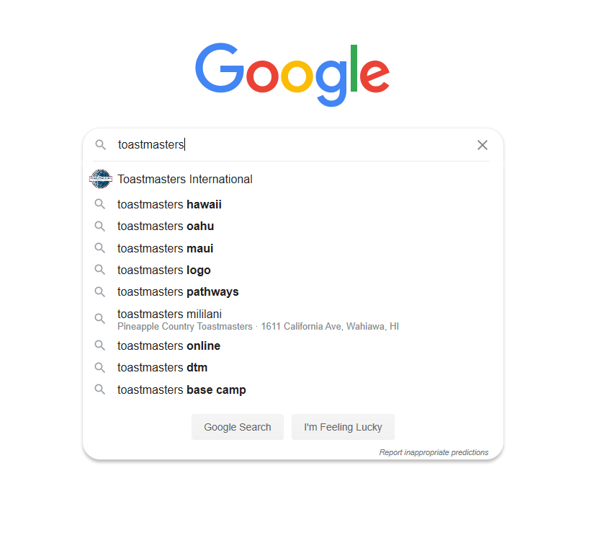
Google

Slide 46
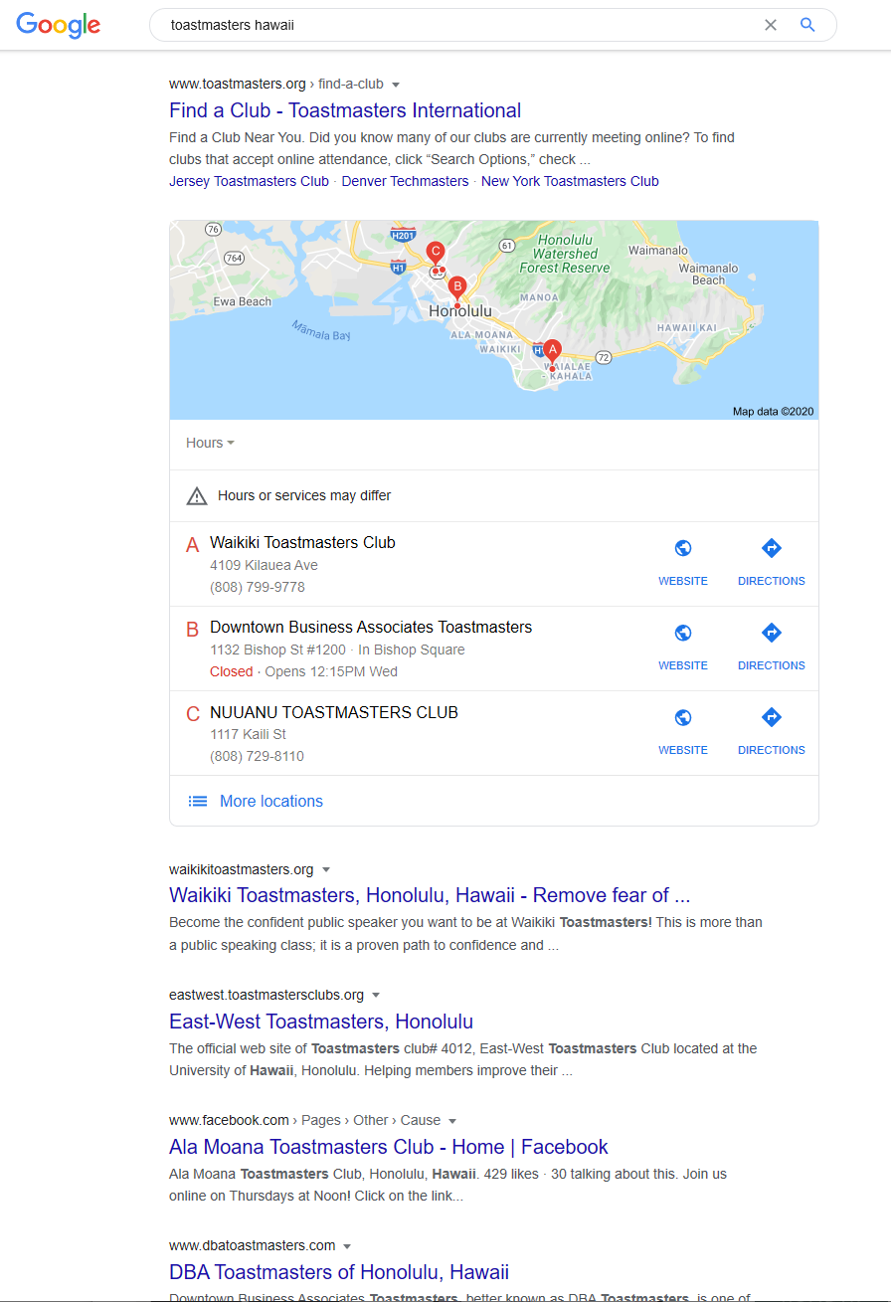
Google
Local Three Pack

Slide 47
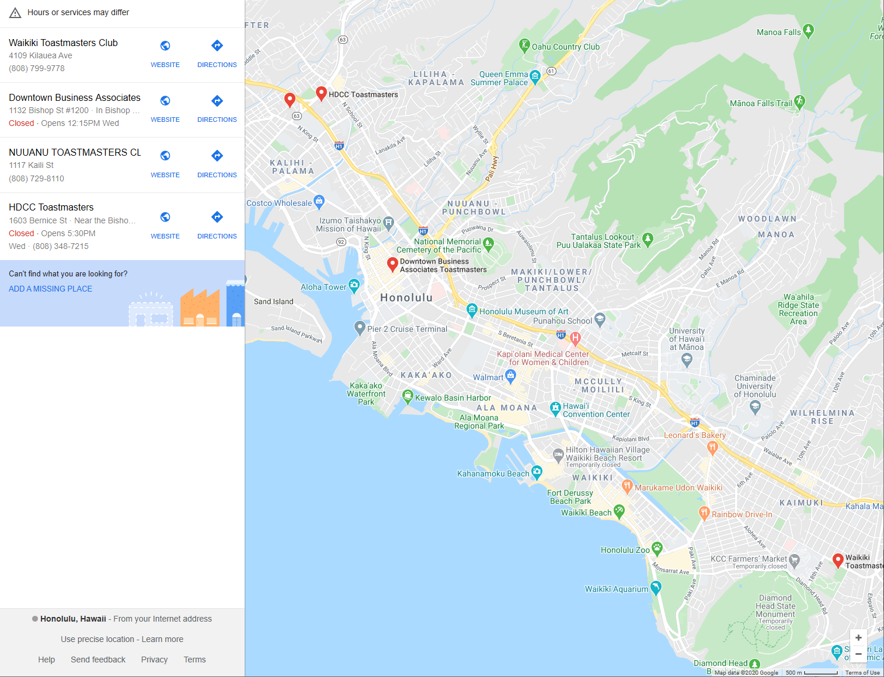
Google
Add Your Club
Club needs to have
a mailing address

Slide 48
Questions…
pr@district49.org

